Slide 1
CSM GAARDS Migration Module
Vijay Parmar

Slide 2
Agenda
Introduction
Requirements
CGMM Components and Overall Architecture
CGMM Workflows
CGMM User Interface
Documentation. Questions?

Slide 3
Introduction
Common Security Module (CSM)
  provides Application security tools that address authentication, authorization and user provisioning.
Grid Authentication and Authorization with Reliably Distributed Services (GAARDS)
  provides services and tools for administration and enforcement of security policy in an enterprise Grid.
CGMM
  A web application tool which allows automated and user-oriented process of migrating CSM user ID to GAARDS user ID and allow an application to use GAARDS based authentication.
Notes:
Common Security Module (CSM) provides Application security tools that address authentication, authorization and user provisioning.
Grid Authentication and Authorization with Reliably Distributed Services (GAARDS) provides services and tools for administration and enforcement of security policy in an enterprise Grid.
CSM GAARDS Migration Module is a web application tool which allows automated and user-oriented process of migrating CSM user’s to GAARDS user’s and allow an application to use GAARDS based authentication.

Slide 4
Requirements
Single Set of Credentials
Migrate CSM based local account to caGrid account.
GAARDS based authentication
Notes:
Single Set of Credentials
The existing web applications having CSM based authentication is required to provide Grid based authentication. Hence users with CSM credentials as well as Grid credentials can access all components of existing web application.
The requirement is to avoid duplication of accounts for existing and new users. The application needs to provide a single set of credentials to access various above mentioned components.
GAARDS based authentication
The requirement is to switch CSM based authentication to caGrid’s GAARDS based authentication. Users should not be allowed to login using CSM credentials once they are migrated.
Migrate Accounts
The Migration module will enable migrating of existing users accounts from CSM accounts to Grid accounts. This will make users authenticated against GAARDS for scalability and federation.
Provisioning of new users with Grid Identities.
New users should be allowed to create Grid accounts and login to existing application using Grid credentials. The existing applications Authorization policy provisioning should be enhanced to allow users Grid Identities instead of CSM credentials.
To use caBIG approved Identity Providers and thus allowing federation of identity
The web application should use a caBIG approved Identity Provider as your credential source. This way any user which is member of those Identity Providers can log onto the application (provided the user has appropriate access permission if any).

Slide 5
CGMM Components
Host Application
  CGMM Filter
CGMM
  CGMM Web Application
  CGMM API
caGrid 1.2 services used by CGMM
  Authetication Service
  Dorian
  SyncGTS
Notes:
The following are the minimum set of components involved in the Migration Module Framework. The following section describes the design for CSM GAARDS Migration Module and integration with Host applications.
CGMM Filter
A new HTTP filter (provided as part of the CGMM) is configured to intercept and forward the user requests to the CGMM to either migrate the user account or to login the user into the Host application. Depending on whether the user is an existing application user or not, the control is passed back either to the login workflow or the new user creation workflow respectively.
CSM – GAARDS Migration Module web application (CGMM)
To assist in the migration of local CSM accounts to caGrid, CGMM is provided. CGMM is a separate web application that resides in the same container as the Host web application. CGMM also provides the Servlet Filter that is placed in front of the Host application intercepting and routing each user request for login or migration purpose. Detailed work flow of the migration module and the considered scenarios are provided in the next section.
Authentication Service
The IdPs registered on NCICB Production Grid will be used as the Identity Provider to validate user’s credentials. They will authenticate the user and provide a SAML token
Dorian
The NCICB Production Dorian is used as a Federation Service to generate user’s grid identity. This Dorian instance will also host all the users migrated from individual local host application instances which are not associated to any other IdPs.
SyncGTS
Sync GTS will be installed in CGMM for the Host application. Sync GTS daemon will keep the Host application in sync with the Grid Trust Fabric and update the CRL’s accordingly. Once the CGMM obtains Grid proxy from Dorian it will validate the proxy against the GTS to make sure the certificate is still valid and has not been revoked.

Slide 6

Host Application
Requested Flow
New User Flow
User Info + Grid Proxy
User Request
CGMM Filter
Pass control
User Info + Grid Proxy
Client
Perform Login
Pass control
CSM LOGIN
GRID LOGIN
CGMM Manager
CSM Login Screen
CSM 4.1 Schema
Validate CSM Credentials
Authentication or Migrate
Grid Login Screen
Authentication Grid User
Authentication Service
Validate Grid Credentials
Create New Dorian User account
Dorian
New Grid User
Screen
Create New Grid User
CGMM Web Tool
Validate Proxy
Web Server
SyncGTS

Slide 7
CGMM Workflows
The CGMM Tool allows multiple scenarios/workflows based on the User. The user may or may not have CSM account. The user also may or may not have a caGrid Account.
Based on the above there are four different scenarios addressed by the CGMM Tool. The scenarios are as following:
  User logs in with CSM account
    User does not have a caGrid account.
    User has a caGrid account
  User logs in with caGrid account
    User does not have a CSM account
    User has a CSM account.
Note: The CGMM tool DOES NOT address the scenario where a User does not have a CSM (local) Account and does not have a caGrid account as well. The host application needs to address this scenario.

Slide 8
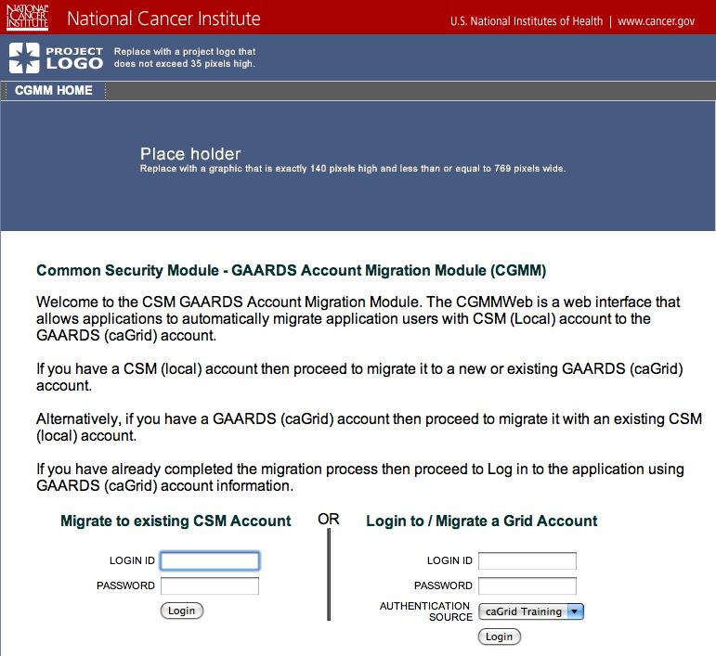
UI – CGMM Home Page

Slide 9
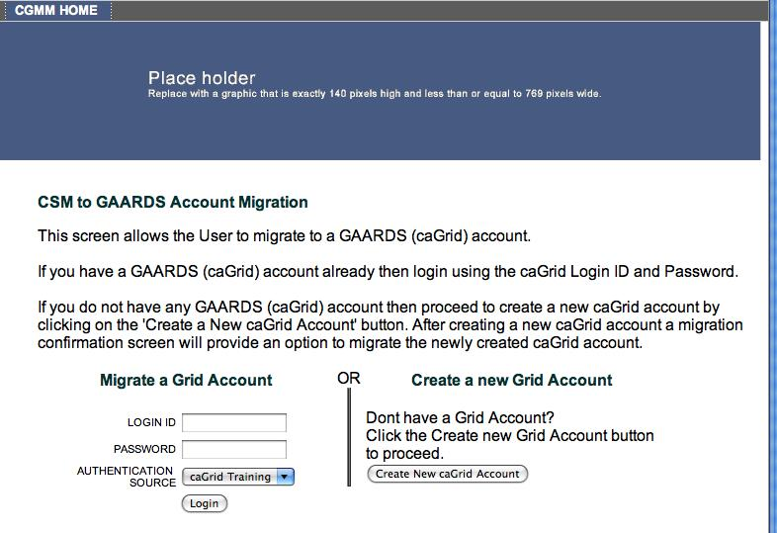
GAARDS Login Page
User is already authenticated with valid CSM login ID and password.

Slide 10
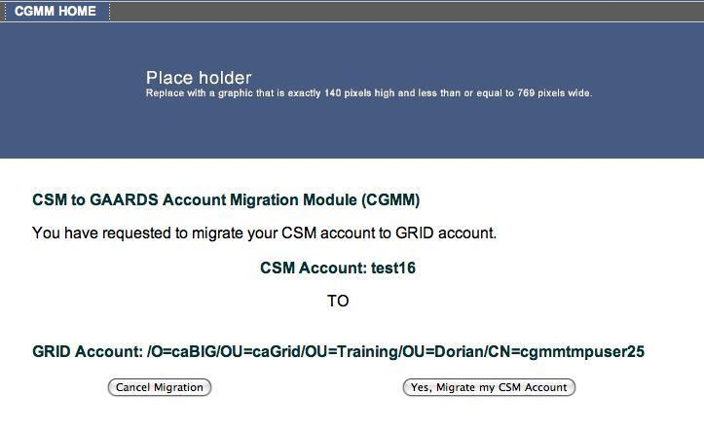
Migration Confirmation Page
- User is already authenticated with valid CSM login ID and password.
User is also authenticated with valid GAARDS (caGrid) based Login ID,
Password against Authentication Source (service).

Slide 11
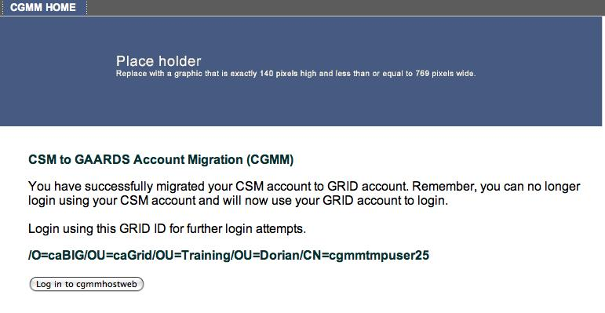
Migration Success page

Slide 12
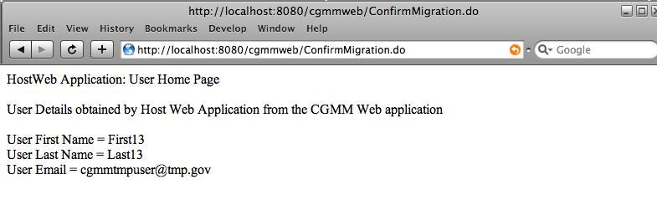
Host application page

Slide 13
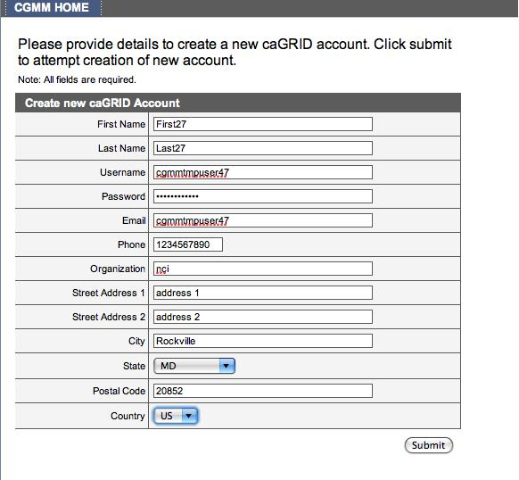
New Grid account page

Slide 14
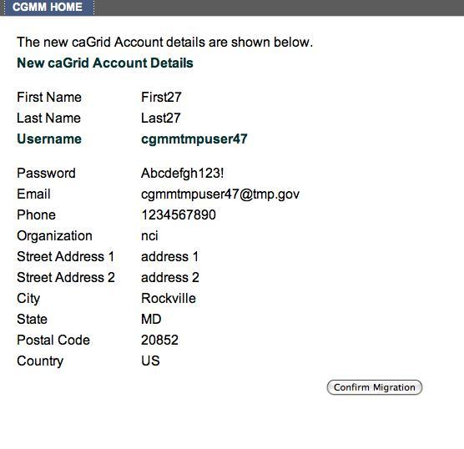
New Grid account confirm page

Slide 15
Technical Environment
CSM V4.1 / CSM UPT v4.1
caGrid Release v1.2

Slide 16
Documentation/More info
CSM GAARDS Migration Module Guide
  http://gforge.nci.nih.gov/docman/view.php/12/15148/CSM41_GAARDSMigrationModuleGuide.pdf
CSM
  http://ncicb.nci.nih.gov/NCICB/infrastructure/cacore_overview/csm
GAARDS
  http://www.cagrid.org/wiki/GAARDS:Main

Slide 17
QUESTIONS?

